Slide 1
MEDIATOR Pattern
The Mediator Design pattern allows you to decouple the direct communication between objects by introducing a middle object, the mediator, that facilitates the communication between the objects. Imagine you have a system where numerous objects communicate with each other by holding the reference to other objects. As the number of object grows and the references to other objects increases the system becomes hard to maintain. The Mediator pattern is designed to solve this problem.
The mediator is the communication center for the objects. When an object needs to communicate to another object, it does not call the other object directly. Instead, it calls the mediator object whose main duty is to route the messages to the destination object

Slide 2
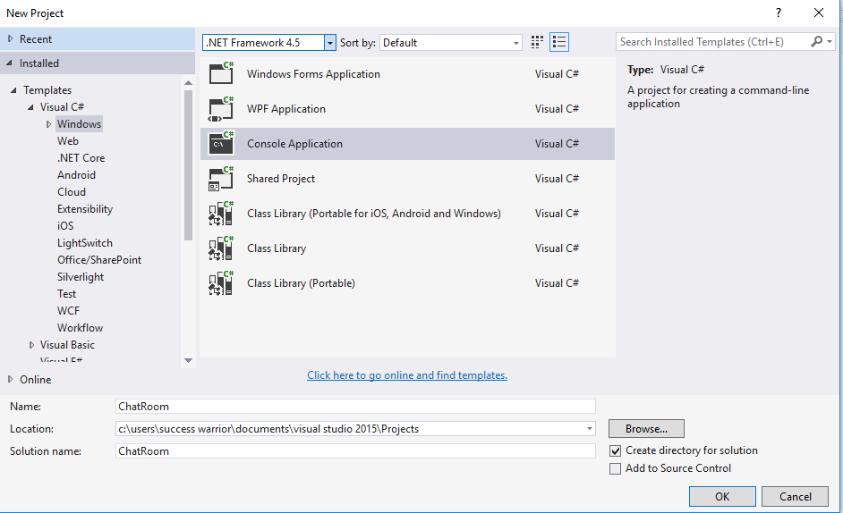

Slide 3
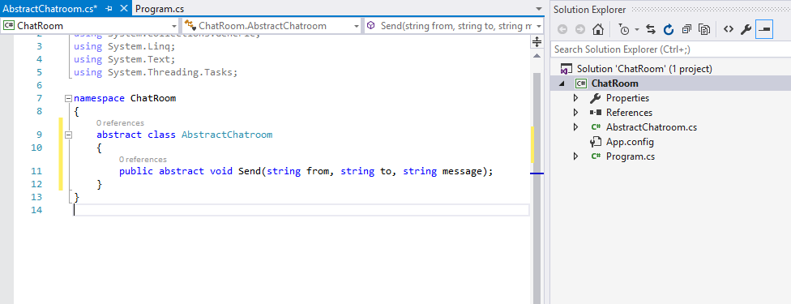


Slide 4
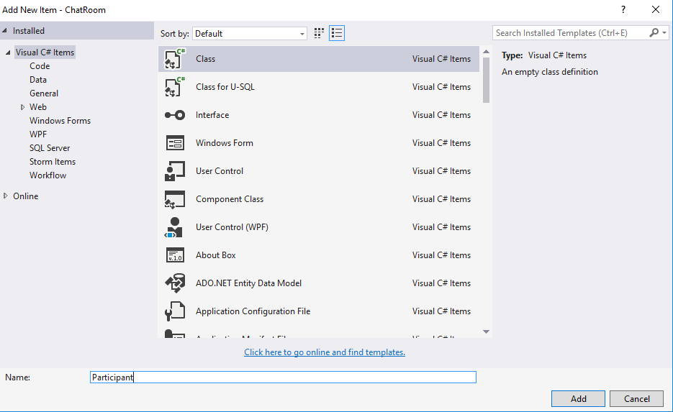

Slide 5
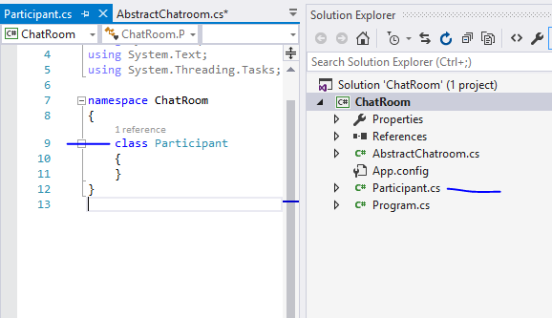
This class will
Associate with
Chatroom abstraction

Slide 6
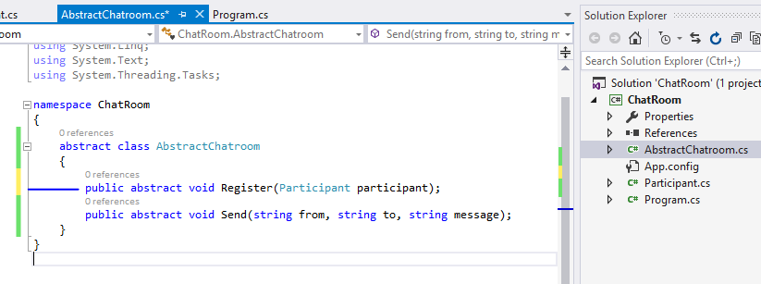

Slide 7
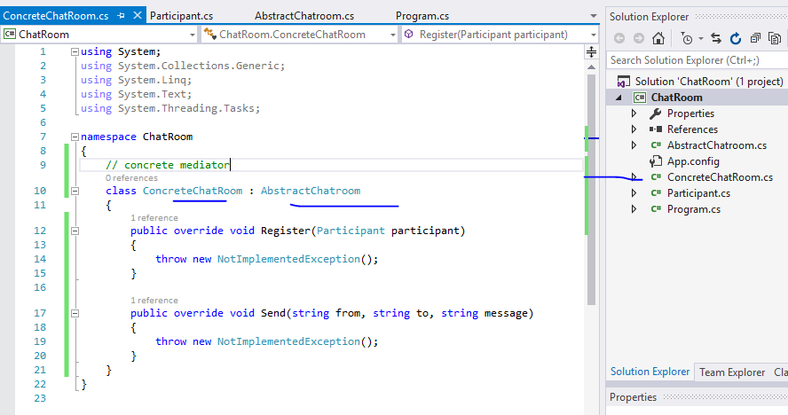


Slide 8
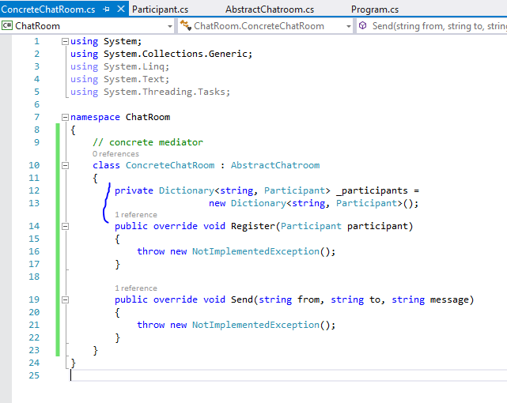


Slide 9
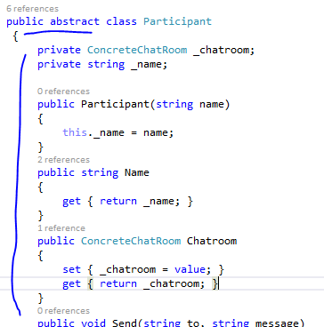

Slide 10
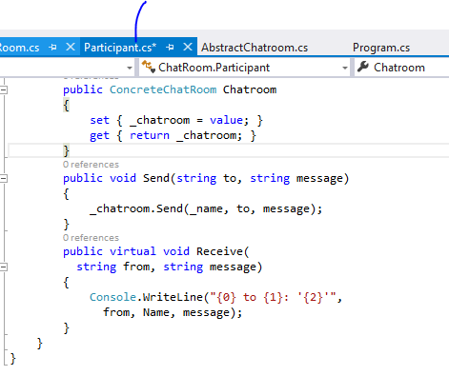

Slide 11
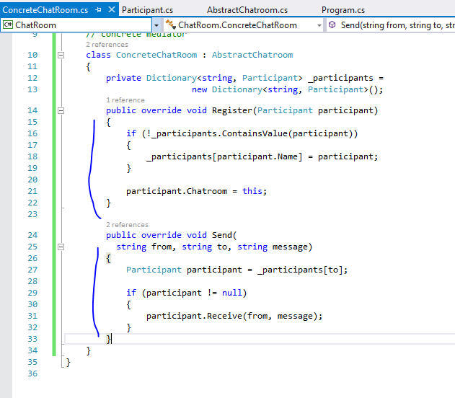

Slide 12
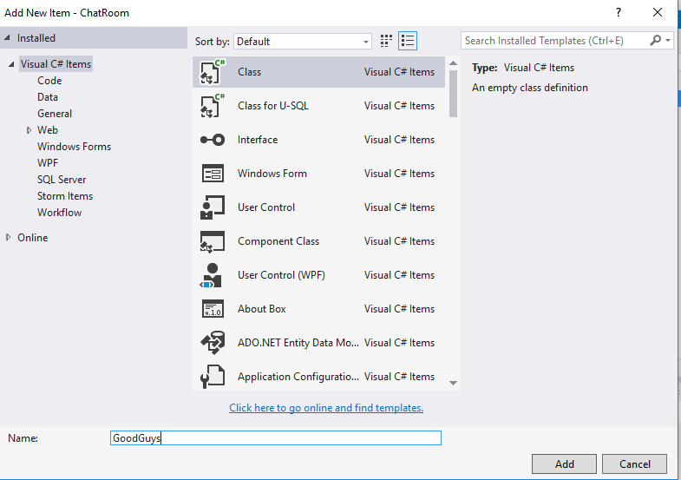

Slide 13
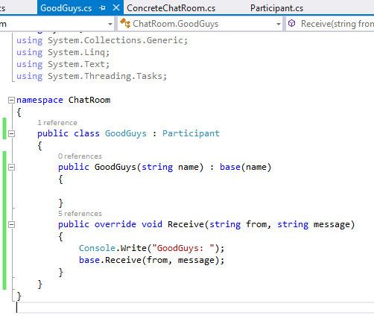
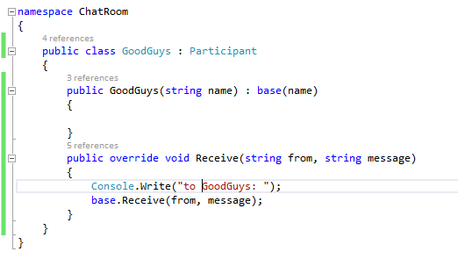

Slide 14
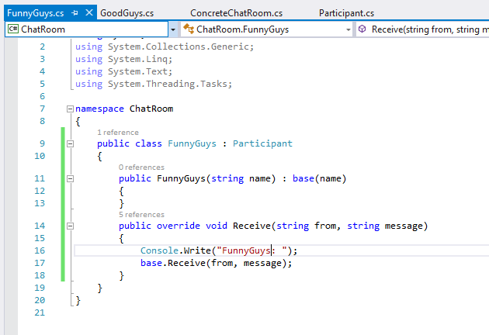
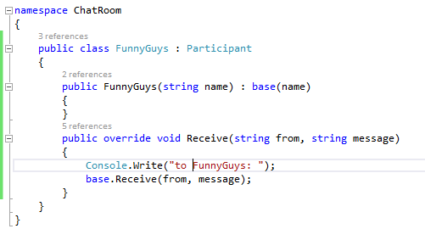

Slide 15
